Slide 1
Shell Bootcamp 2024 4 Reflections for Week #2
Khushi Garg
Date : 06-Sept-2024

Slide 2

About Me
Stay vigilant, trust but verify, and protect what matters.

Slide 3

My learnings from this week!

Slide 4

Learning 1 | My takeaways
Key learning
Software Testing is an activity that helps in identifying bug/defects in a software system under development to detect the variations from specifications and to reduce the risk inherited.
It supports the developers to build defect free software by identifying defects.

Slide 5
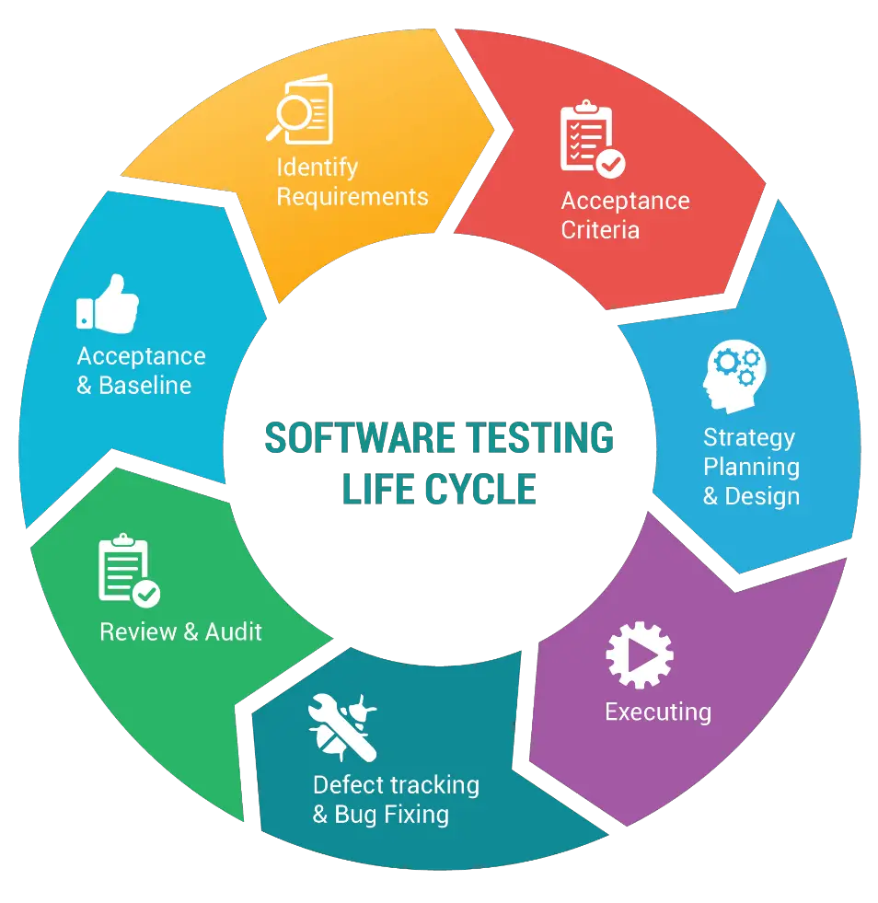
Learning 2 | My takeaways
Key learning
Software testing life cycle
It defines the stages or phases in testing of software.
In general the software testing starts from the requirement phase and ends with deployment phase.

Slide 6
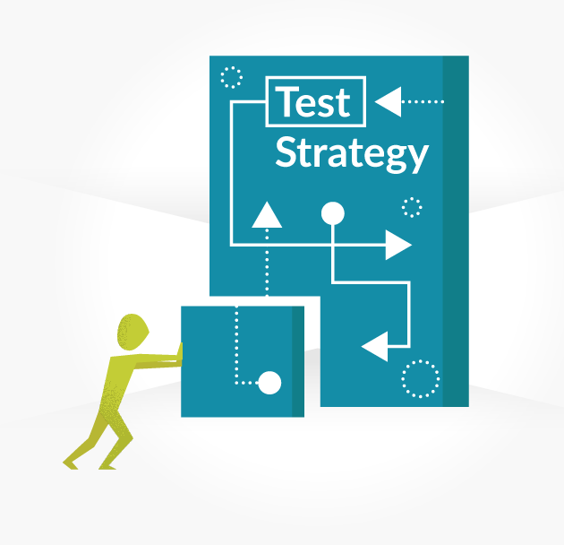
Learning 3 | My takeaways
Key learning
Test Strategy
A concise statement of how to meet the objectives of testing effectively in limited time by optimal use of resources.
Establish the framework for testing the system.
Requirements are analyzed.

Slide 7
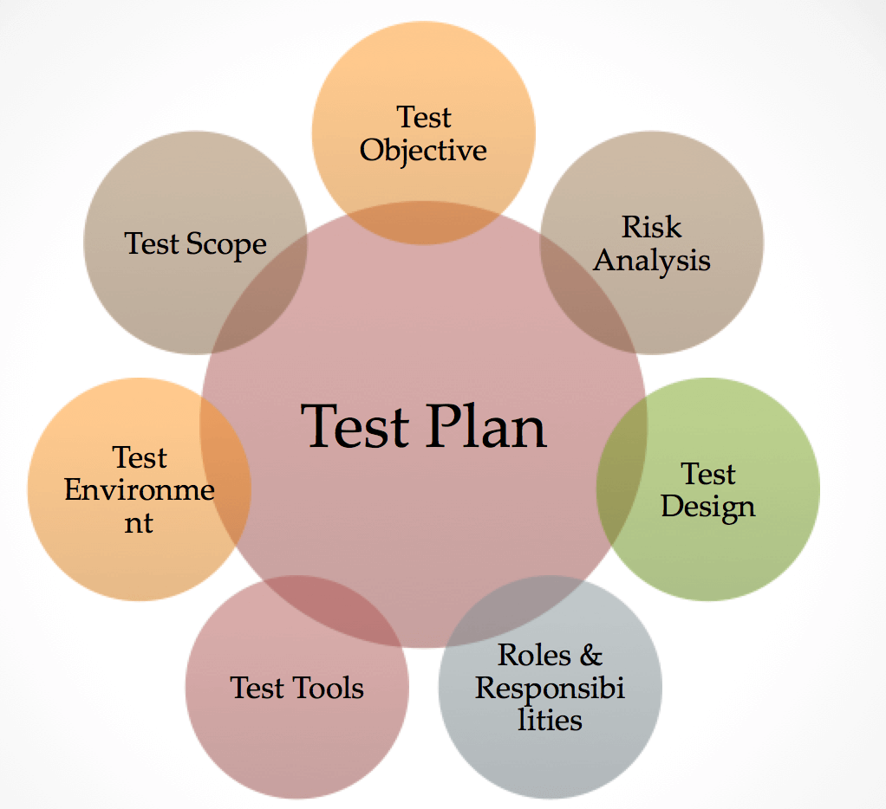
Learning 4 | My takeaways
Key learning
Test Plan
A document that contains the objectives, scope of testing, approach to be followed, schedule, roles and responsibility.
Creates the test plan deliverable according to the standard.
Test effort estimation.
Determine roles and responsibilities.

Slide 8

Relevance of learnings for my organization

Slide 9

Learning 1 | Relevance for Shell
How I feel Shell implements this learning
Shell implements effective software testing by integrating testing early in development, using automated tools, and maintaining defect-tracking systems. This approach helps identify and fix defects quickly, reduces risks, and supports building defect-free software.

Slide 10
Learning 2 | Relevance for Shell
How I feel Shell implements this learning
Shell implements the Software Testing Life Cycle (STLC) by incorporating testing at every phase, from the requirements phase to the deployment phase. This structured approach ensures thorough software validation at each stage, allowing early detection and resolution of defects.

Slide 11
Learning 3 | Relevance for Shell
How I feel Shell implements this learning
Shell implements the Test Strategy by developing a clear plan that defines how testing objectives will be met efficiently within time and resource constraints. This involves analyzing requirements, identifying testing scope, and determining the tools, techniques, and resources needed. A well-defined test strategy establishes a structured framework for testing, ensuring that testing efforts are focused, prioritized, and aligned with business goals.

Slide 12
Learning 4 | Relevance for Shell
How I feel Shell implements this learning:
Shell can implement a Test Plan by creating a detailed document that outlines the objectives, scope, testing approach, schedule, and roles and responsibilities for the testing process. This document serves as a blueprint, guiding the testing efforts and ensuring alignment with project standards. It includes test effort estimation, and resource allocation, and clearly defines who is responsible for each task, providing a structured and efficient testing process that meets project timelines and quality goals.

Slide 13

Challenges in implementing learning

Slide 14

Challenge faced while implementing Learning 1
Challenges faced while implementing:
Incomplete Requirements: Unclear or missing specifications make comprehensive testing difficult.
Time Constraints: Tight deadlines limit thorough testing, increasing the risk of missed defects.
Environment/Tool Issues: Challenges in setting up testing environments and selecting appropriate tools.

Slide 15
Challenge faced while implementing Learning 2
Challenges faced while implementing:
Challenges in implementing the Software Testing Life Cycle (STLC):
1. Changing Requirements: Incomplete or evolving requirements make it hard to plan and execute tests effectively.
2. Resource Constraints: Limited time and resources can restrict thorough testing.
3. Team Integration: Poor collaboration between testing and development teams can cause miscommunication and delays.

Slide 16
Challenge faced while implementing Learning 3
Challenges faced while implementing:
- Resource Allocation: Balancing limited resources effectively while meeting testing objectives can be challenging, requiring careful planning and prioritization.
- Time Constraints: Ensuring thorough testing within a limited timeframe can be difficult, potentially leading to missed defects or incomplete coverage.
- Requirement Analysis: Accurately analyzing and translating requirements into a test strategy can be complex, impacting the effectiveness of the testing framework.

Slide 17
Challenge faced while implementing Learning 4
Challenges faced while implementing:
- Scope Definition: Clearly defining the scope and objectives can be challenging, leading to potential misalignment with project goals.
- Resource Allocation: Estimating test effort and assigning appropriate roles may be difficult, affecting the plan's effectiveness.
- Standard Compliance: Ensuring that the test plan meets all standard requirements can be complex and time-consuming.

Slide 18

Action Plan

Slide 19
My Action Plan for this Week
Actions
Timeline
Status
Learning more about Azure DevOps and creating the Agile projects in it.
Creating the Virtual Machine in Azure.
Setting up PostgreSQL and working on the SQL queries.
Networking with colleagues.
1 Week
Ongoing

Slide 20

Learning is also Fun!

Slide 21

Learning is also Fun!
My learning was fun this week because of the following reasons:
In-class presentations
Assessments and Quiz
Playing Games
Networking with colleagues

Slide 22

Summary
Software Testing: Integrate testing early and continuously throughout development to identify defects, reduce risks, and support defect-free software creation.
Software Testing Life Cycle (STLC): Follow a structured approach from the requirements phase to deployment, ensuring thorough validation at each stage.
Test Strategy: Develop a clear and efficient plan to meet testing objectives by analyzing requirements, optimizing resource use, and establishing a framework.
Test Plan: Create a comprehensive document detailing objectives, scope, approach, schedule, and roles to guide testing efforts, estimate resources, and ensure adherence to standards.

Slide 23
Thank You

